Slide 1
Scrum in a nutshell

Slide 3
Sprint Framework
Roles | Ceremonies | Artifacts
Product Owner | Sprint Planning | Product Backlog
Scrum Master | Daily Scrum Meeting | Sprint Backlog
Team Members | Sprint Review | Sprint Burndown
Other Stake Holders | Sprint Retrospective | Team Velocity

Slide 4
Sprint Framework
Roles | Ceremonies | Artifacts
Product Owner | Sprint Planning | Product Backlog
Scrum Master | Daily Scrum Meeting | Sprint Backlog
Team Members | Sprint Review | Sprint Burndown
Other Stake Holders | Sprint Retrospective | Team Velocity

Slide 5
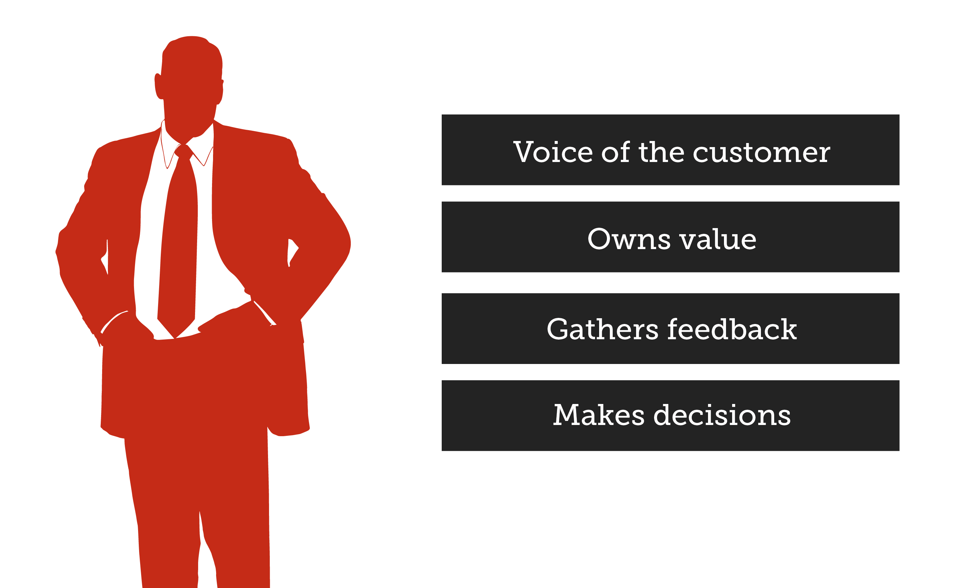
Product Owner
Notes:
Defines the features of the product
Decides release date and content
Responsible for the profitability of the product
Prioritizes features according to market value
Adjusts features and priority

Slide 6
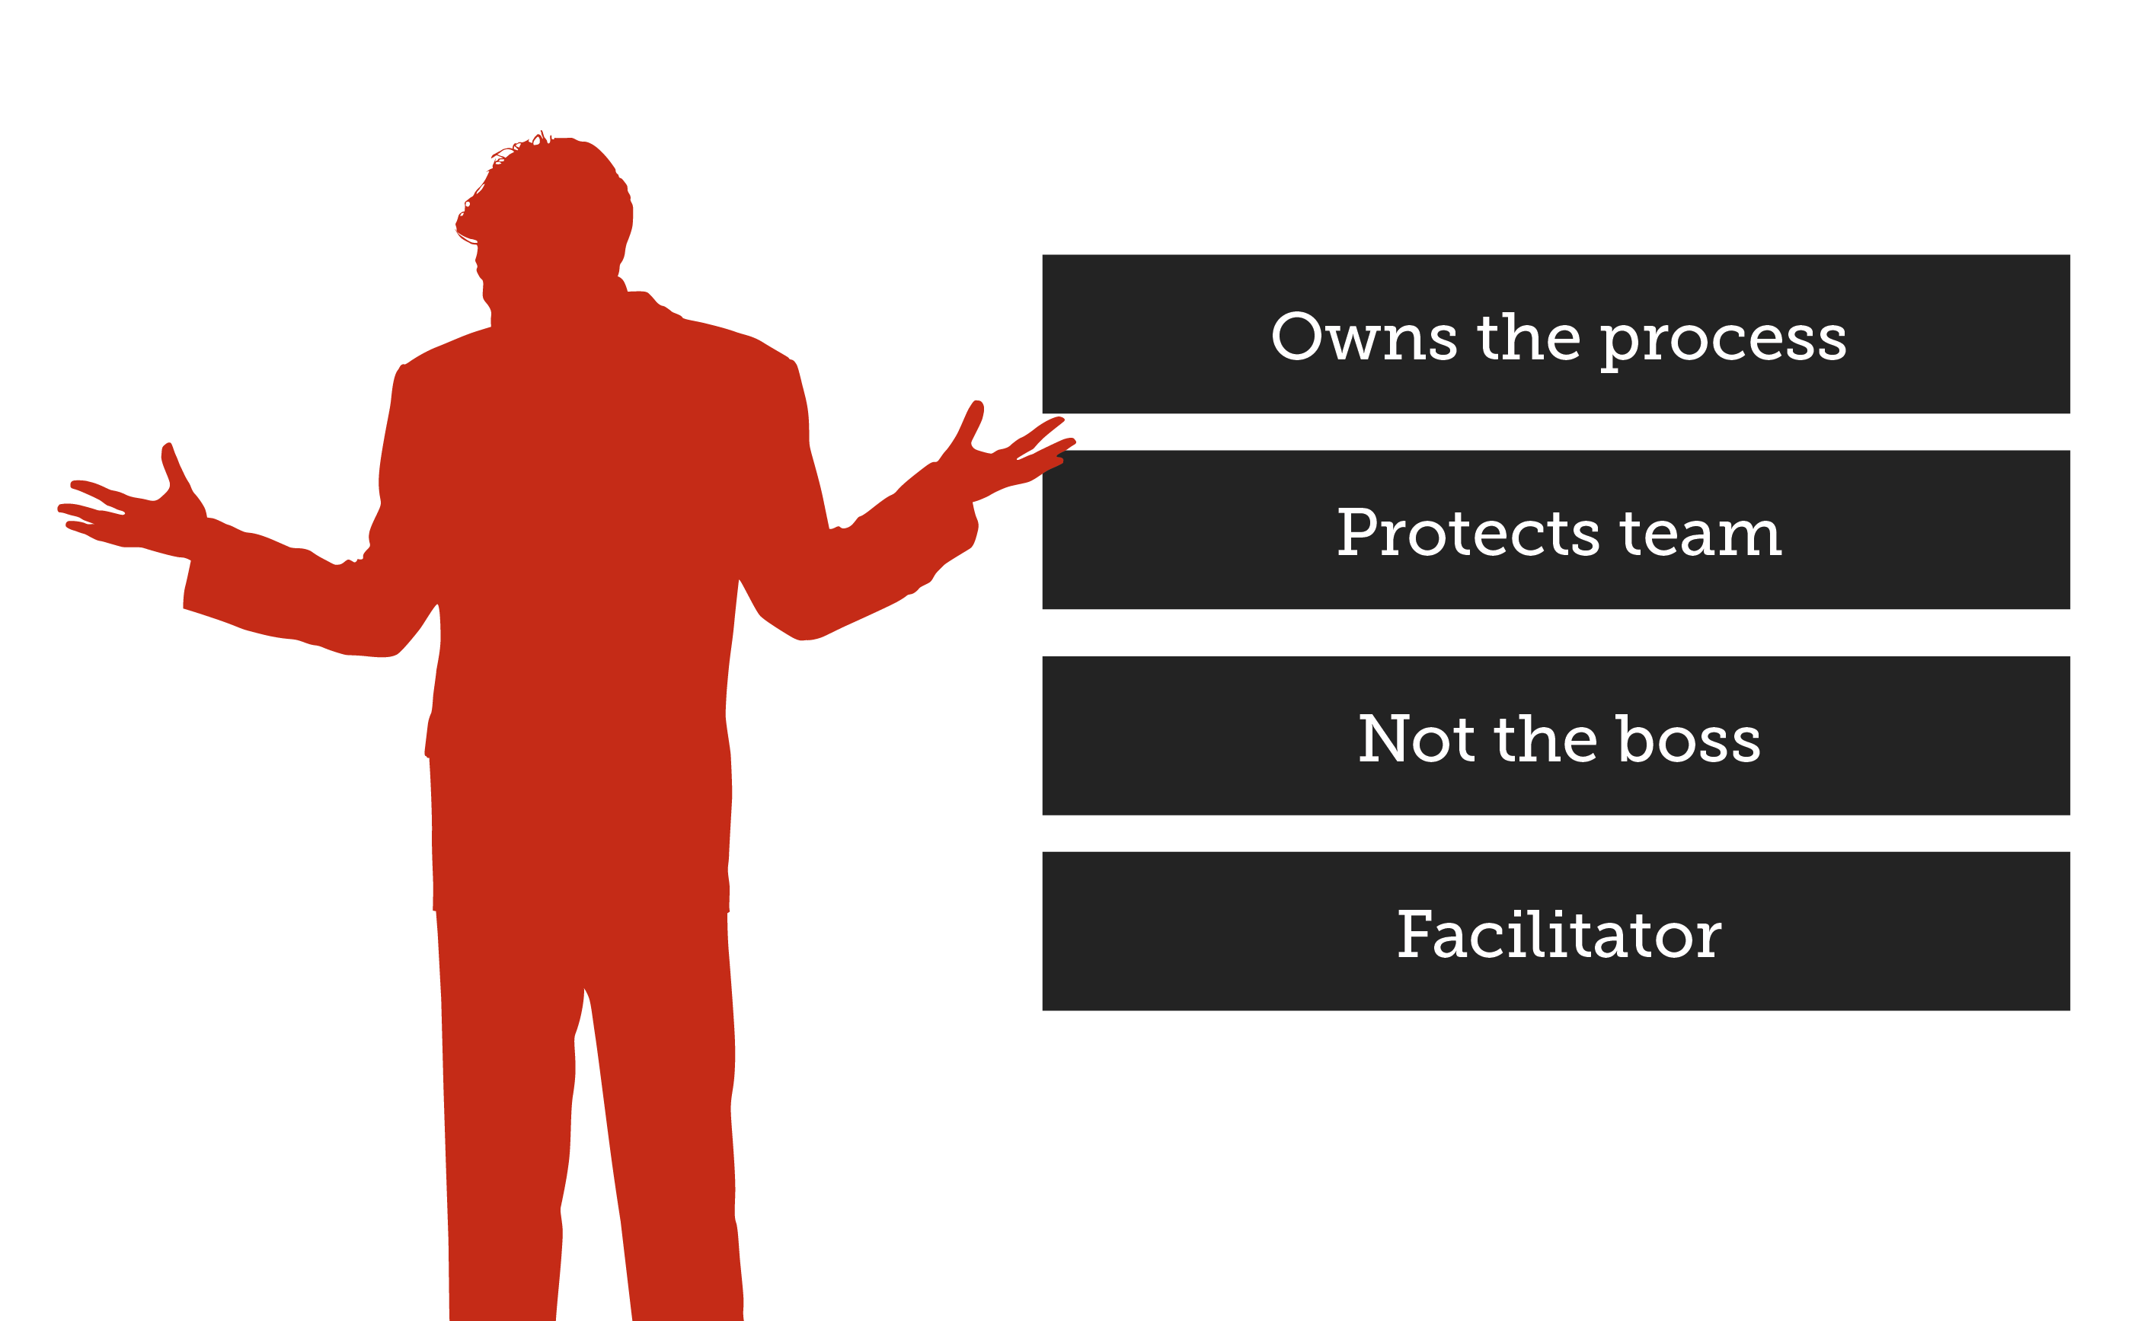
Scrum Master
Notes:
Manages the project
Ensure that the team is fully functional and productive
Removes impediments

Slide 7

Team Members
Teams are self-organized
Typically 5-9 people
Committed for the project

Slide 8


The ‘Pig’ and the ‘Chicken’

Slide 9
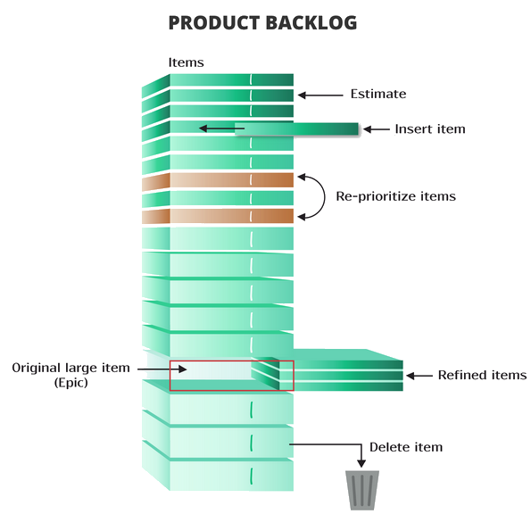
Product Backlog

Slide 10
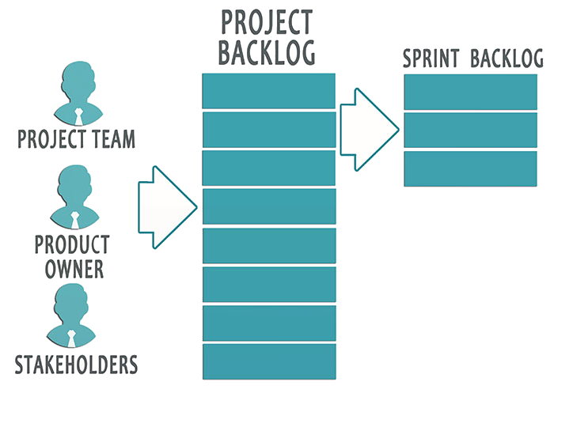
Sprint Backlog

Slide 11


Sprint Planning
Team capacity
Sprint planning meeting
Sprint prioritization
Product backlog
Sprint
goal
Analyze and evaluate product backlog
Select sprint goal
Business conditions
Sprint planning
Decide how to achieve sprint goal
Create sprint backlog from product backlog
Estimate sprint backlog
Current product
Sprint
backlog
Technology

Slide 12
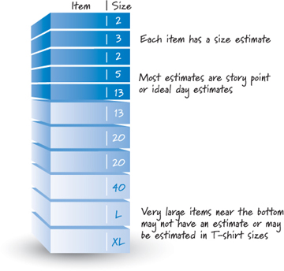
Sprint Planning (Estimation)

Slide 13
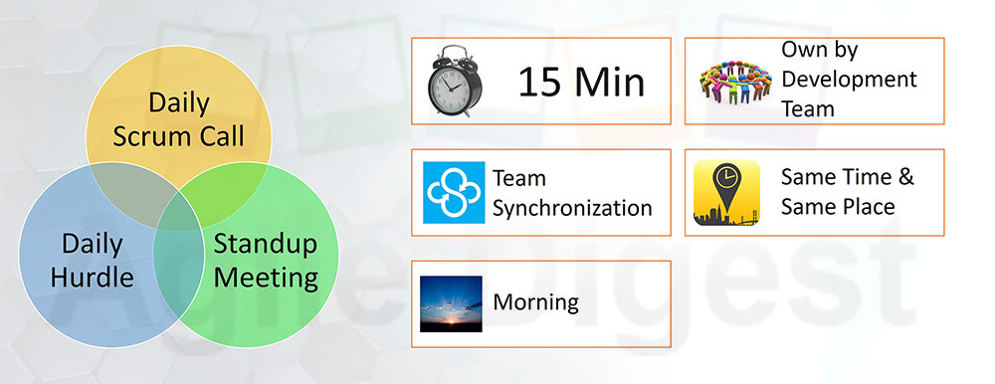
Daily Scrum Meeting

Slide 14
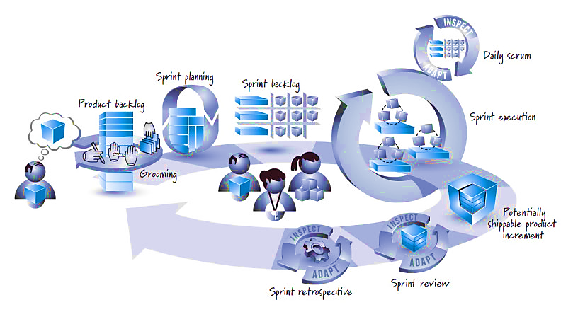
Summary

Slide 15


My Books + Video Subscriptions
books.kunal-chowdhury.com

Slide 16
Connect with Me
kunal-chowdhury.com
twitter.com/kunal2383
facebook.com/blog.kunal

